Slide 1

Madanapalle Institute of Technology and Science
Master of Computer Applications
Movie Recommendation System using Hybrid Filtering and Sentimental Analysis
Under Guidance:-
Dr . R . Maruthamuthu
Assistant Professor
Presented by:-
G.Gopalakrishna
(20691F0030)

Slide 2
Contents
              Abstract
              Introduction
              Existing System
              Proposed System
              Hardware/Software Specifications
              Module Description
              UML Diagrams

Slide 3
Abstract
As humans’ opinions help enhance product efficiency, and since the success or the failure of a movie depends on its reviews, there is an increase in the demand and a need to build a good sentiment analysis model that classifies movie ratings.
In this research, tokenization is employed to transfer the input string into a word vector, stemming is utilized to extract the root of the words, feature selection is conducted to extract the essential words, and finally, classification is performed to label reviews as being either positive or negative.

Slide 4
Introduction
In today’s world, the internet has become an important part of human life. Recommendation systems (RS) are deployed to help users cope with this information explosion.
RS is mostly used in e-commerce applications and knowledge management systems such as tourism, entertainment, and online shopping portals. In this paper, we focus on RS for movies are an important source of recreation and entertainment in our life.
Movies can be easily differentiated through their genres like comedy, thriller, animation, and action.
Another possible way to categorize movies can be achieved on the basis of metadata such as year, language, director, or cast.
Most online video-streaming services provide a number of similar movies to the user to utilize the user’s previously viewed or rated history.

Slide 5
Existing System
In the existing system where we can’t identify the rating of any kind of movie rating or app rating etc.
We don’t know which movie is the best movie at present we blindly follow based on analyses of the people either movie is good or bad based on that which people use to follow it.

Slide 6
Disadvantages
Difficult to predict
Requires more time

Slide 7
Proposed System
We can predict the movie rating by using Machine-learning,it gives the best result and we can predict the movie based on the Machine-learning technique,here we can say which movie is good or bad.
The proposed system is built by using the concept of Machine learning and the KNN algorithm, which are used to solve the classification problems.

Slide 8
Advantages
High accuracy.
Time Saving.
High reliability.
Low complexities.

Slide 9
Software /Hardware Specifications
Software Specifications:
Operating System : Windows 7+
Server-side Script : Python
IDE : Jupyter Notebook.
Libraries Used : Pandas, Numpy, Matplotlib.

Slide 10
Hardware Specifications:
Processor : I3/Intel Processor
RAM : 4GB (min)
Hard Disk : 128 GB
Key Board : Standard Windows Keyboard
Mouse : Two or Three Button Mouse
Monitor : Any

Slide 11
Module Descriptions
This Movie Recommendation System Project has the major modules below:
Admin:
Admin has the official powers to control the flow of data from one part of the system to other.
He can manipulate the access of the users to the data.
Reviews:
Reviews are collected from the users randomly.
Admin can able to view reviews based on the reviews movie recommendations will be generated.

Slide 12
Module Descriptions
Users:
A project user is defined as any user who is a member of any group within the project.
User will manage Registration, Login, view recommendations, enter reviews, view history, view reviews, etc.
Recommendations:
After verifying all the reviews of the movies.
Based on the reviews the movies will be going to recommended.

Slide 13
Use Case Diagram
A use case diagram in the Unified Modeling Language (UML) is a type of behavioral diagram defined by and created from a Use-case analysis.
Its purpose is to present a graphical overview of the functionality provided by a system in terms of actors, their goals (represented as use cases), and any dependencies between those use cases.
The main purpose of a use case diagram is to show what system functions are performed for which actor. The roles of the actors in the system can be depicted.

Slide 14
Registration
Login
Login
Enter Movie Name
View Users
View Recommendations
View Reviews
Enter Movie Reviews
Admin
View History
View History
User
View Reviews
Log out
Log out

Slide 15
Sequence Diagram
A sequence diagram in Unified Modeling Language (UML) is a kind of interaction diagram that shows how processes operate with one another and in what order.
It is a construct of a Message Sequence Chart. Sequence diagrams are sometimes called event diagrams, event scenarios, and timing diagrams.

Slide 16
User
System
Admin
Preprocessing
Evaluation
Registration
Login
Login
View Users
Enter Movie Name
View Recommendations
View Reviews
Enter Reviews
View History
View History
View Reviews
Log Out
Log out

Slide 17
Class Diagram
In software engineering, a class diagram in the Unified Modeling Language (UML) is a type of static structure diagram that describes the structure of a system by showing the system's classes, their attributes, operations (or methods), and the relationships among the classes. It explains which class contains information.

Slide 18
User
Admin
User_Id
User_password
User_dob
User_Name
User_address
Login()
Registration()
Login()
View History()
View Reviews()
Logout()
Admin_id
Admin_password
Admin_dob
Admin_Name
Login()
View Users()
View Reviews()
View History()
Logout()
Movie
Movie_Id
Movie_Title
Movie_genre
Movie_Comment
Movie_Description
Recommendations()
Reviews()

Slide 19
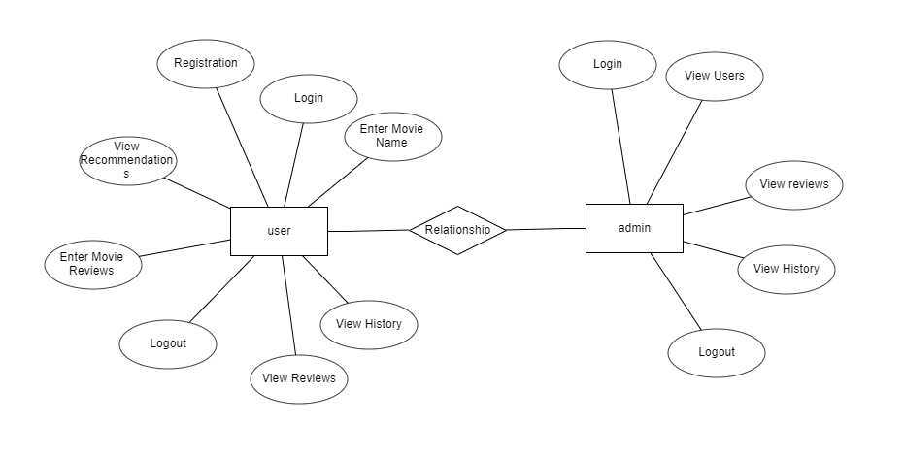
ER Diagram
An Entity–relationship model (ER model) describes the structure of a database with the help of a diagram, which is known as Entity Relationship Diagram (ER Diagram). An ER model is a design or blueprint of a database that can later be implemented as a database. The main components of E-R model are: entity set and relationship set.

Slide 20
Activity Diagram
Activity diagrams are graphical representations of workflows of stepwise activities and actions with support for choice, iteration, and concurrency.
In the Unified Modeling Language, activity diagrams can be used to describe the business and operational step-by-step workflows of components in a system. An activity diagram shows the overall flow of control.

Slide 22
Deployment Diagram
The deployment diagram represents the deployment view of a system. It is related to the component diagram. Because the components are deployed using the deployment diagrams.
A deployment diagram consists of nodes. Nodes are nothing but physical hardware used to deploy the application.

Slide 23
The research goal of this work is to address by constructing an approach that can classify movie ratings and then compare the results in an inclusive study of well-known classifier. To evaluate the proposed model, movie reviews dataset was utilized. Tokenization was applied on the dataset to transfer strings into word vector, then stemming was used to extract the root of the words, afterwards gain ratio was applied on the dataset as an attribute selection algorithm.

Slide 24


